Slide 1
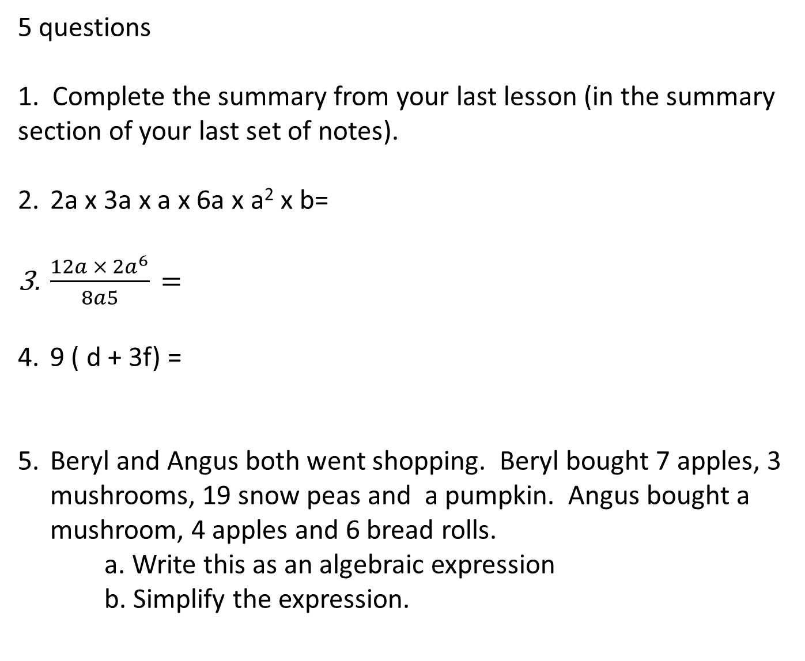
5 questions
1. Complete the summary from your last lesson (in the summary section of your last set of notes).
2a x 3a x a x 6a x a² x b=
$\frac{12a × {2a}^{6}}{8a5}\text{ = }$
9 ( d + 3f) =
Beryl and Angus both went shopping. Beryl bought 7 apples, 3 mushrooms, 19 snow peas and a pumpkin. Angus bought a mushroom, 4 apples and 6 bread rolls.
a. Write this as an algebraic expression
b. Simplify the expression.
Notes:
hook

Slide 2
How well do you remember multiplying and divide positive and negative numbers?
12 x -3 =
-5 x -4 =
-3 x 6 =
15 ÷ -3 =
-36 ÷ -4 =
-42 ÷ 6 =
What do you think will happen now?
12a x -3 =
-5b x -b =
-3g x 6k =
15f ÷ -3 =
-36q² ÷ -4q =
-42r ÷ 6s =

Slide 3

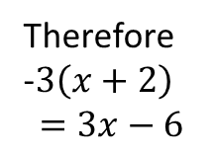
24
7
30
Date
Distributive law
EQ – How can we expand brackets when negatives are involved?
Method 1:
Steps
Expand $−3\left(x+2\right)$
X 2
-3
-3x
-6
Therefore
-$3\left(x+2\right)$ $$=3x−6$$
Notice the sign changes
5
Notes:
Lesson objective (EQ)

Slide 4


Date
24
7
30
Date
24
7
30
Distributive law
EQ –
– How can we expand brackets when negatives are involved?
Method 2:
Steps
Expand -$5\left(x−2\right)$
-5 $\left(x−2\right)$
$$−5x − −10$$
$$−5x+10$$
Be careful the sign changes!
5
5
Notes:
Input

Slide 5

Try these
Expand the following
-4(d+2)
-10(4 - s)
-3(2x+7)
Notes:
Check for understanding

Slide 6
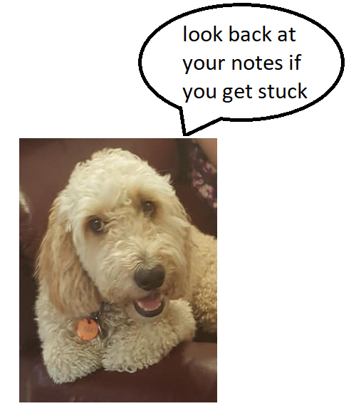
Pg 40 Dwyer book
Complete exercise 3.9 and 3.10
Notes:
Independent practice

